Slide 1
BBIT121/CISY110
Introduction to Programming
Functions in C++

Slide 2
Introduction
A function is a block of code that performs a specific task.
Dividing a complex problem into smaller chunks makes our program easy to understand and reusable.
There are two types of function:
Standard Library Functions: Predefined in C++
User-defined Function: Created by users

Slide 3
User defined functions
A user-defined function groups code to perform a specific task and that group of code is given a name (identifier).
When the function is invoked from any part of the program, it all executes the codes defined in the body of the function.
Syntax: returnType functionName (parameter1, parameter2,...) {
// function body
}
User-defined functions can be categorized as:
Function with no argument and no return value
Function with no argument but return value
Function with argument but no return value
Function with argument and return value

Slide 4
Example - 1
E.g. void printN (int num)
{
cout << num;
}
E.g. int Sum(int num1, int num2)
{
int s;
s = num1 + num2;
return s;
}
In the first example:
the name of the function is printN()
the return type of the function is void
the function has one parameter of type integer.
the function body is written inside { }
Note: A parameter is a value that is passed when declaring a function.

Slide 5
Example - 2
In the second example:
the name of the function is Sum()
the return type of the function is int, implying that it will return a value to the calling function
the function has two parameters of type integer
the function body is written inside { }

Slide 6
Calling a function
To use the printN() and Sum functions, we need to call it (them). Here's how we can call the above functions:
int main()
{
int x, y, z;
cout<<“Enter values”<<endl;
cin>>x>>y;
z = Sum (x,y); //function call
printN(z); //function call
}

Slide 7
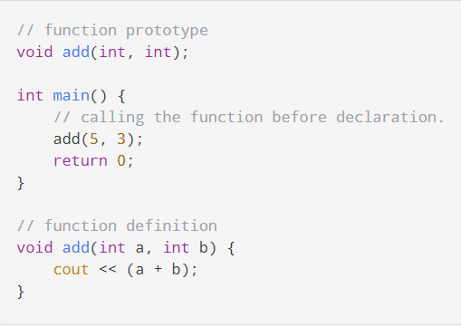
Function prototype
In C++, the code of function declaration should be before the function call. However, if we want to define a function after the function call, we need to use the function prototype. For example,
The function prototype provides the compiler with information about the function name and its parameters. That's why we can use the code to call a function before the function has been defined.
The syntax of a function prototype is:
returnType functionName(dataType1, dataType2, ...);

Slide 8
Passing by value and by reference
In C++ we can pass arguments into a function in different ways. These different ways are:
Pass by Value
Pass by Reference
Pass By Value
The local parameters are copies of the original arguments passed in
Changes made in the function to these variables do not affect originals
Pass By Reference
The local parameters are references to the storage locations of the original arguments passed in.
Changes to these variables in the function will affect the originals
No copy is made, so overhead of copying (time, storage) is saved

Slide 9
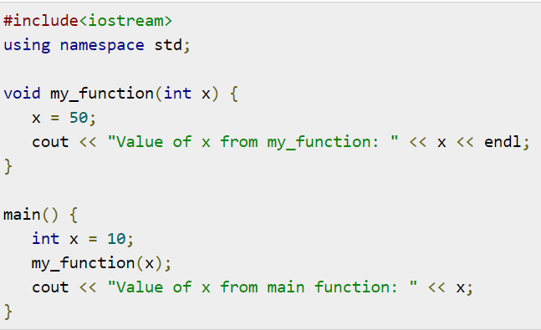
Pass by value

Slide 10
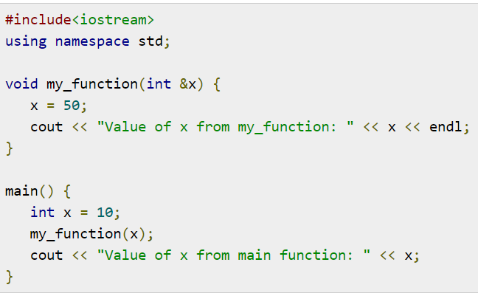
Pass by reference
When to use pass by reference:
The call by reference is mainly used when we want to change the value of the passed argument into the invoker function.
One function can return only one value. When we need more than one value from a function, we can pass them as an output argument in this manner.

Slide 11
Benefits of Using User-Defined Functions
Functions make the code reusable. We can declare them once and use them multiple times.
Functions make the program easier as each small task is divided into a function.
Functions increase readability.

Slide 12
C++ Library Functions
Library functions are the built-in functions in C++ programming.
Programmers can use library functions by invoking the functions directly; they don't need to write the functions themselves.
Some common library functions in C++ are sqrt(), abs(), isdigit(), etc.
In order to use library functions, we usually need to include the header file in which these library functions are defined.
For instance, in order to use mathematical functions such as sqrt() and abs(), we need to include the header file cmath.

Slide 13
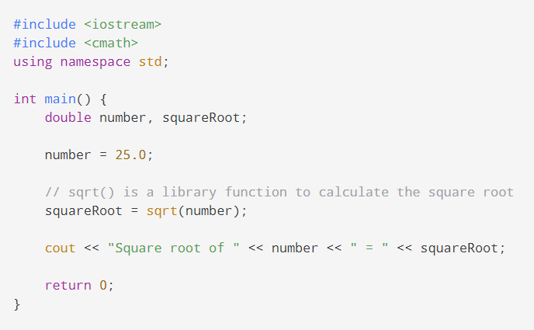
example
In this program, the sqrt() library function is used to calculate the square root of a number.
The function declaration of sqrt() is defined in the cmath header file. That's why we need to use the code #include <cmath> to use the sqrt() function.

Slide 14
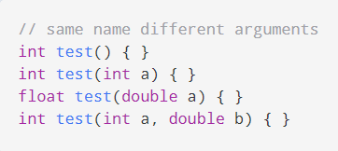
Function overloading
This is when two functions have the same name if the number and/or type of arguments passed is different.
These functions having the same name but different arguments are known as overloaded functions.
In the above, all 4 functions are overloaded functions.
Notice that the return types of all these 4 functions are not the same.
Overloaded functions may or may not have different return types but they must have different arguments.

Slide 15
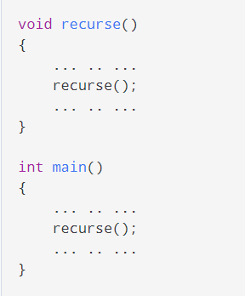
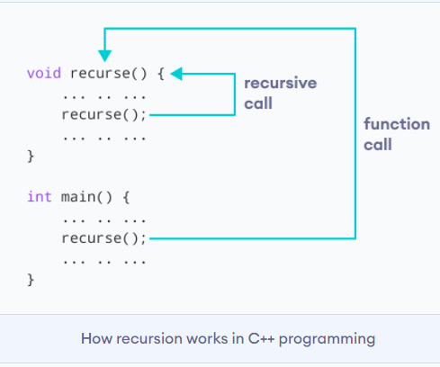
recursion
A function that calls itself is known as a recursive function. And, this technique is known as recursion.
The recursion continues until some condition is met.
To prevent infinite recursion, if...else statement (or similar approach) can be used where one branch makes the recursive call and the other doesn't.

Slide 16
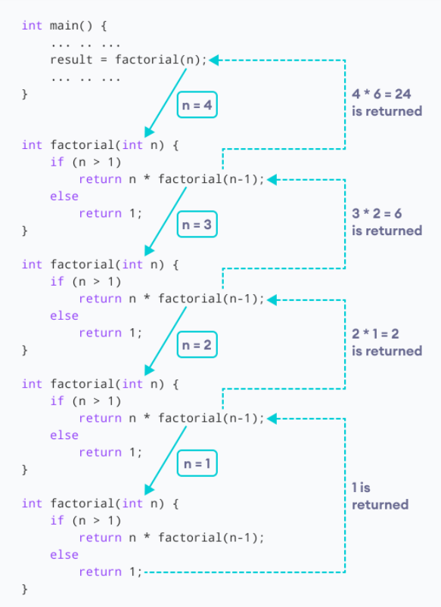
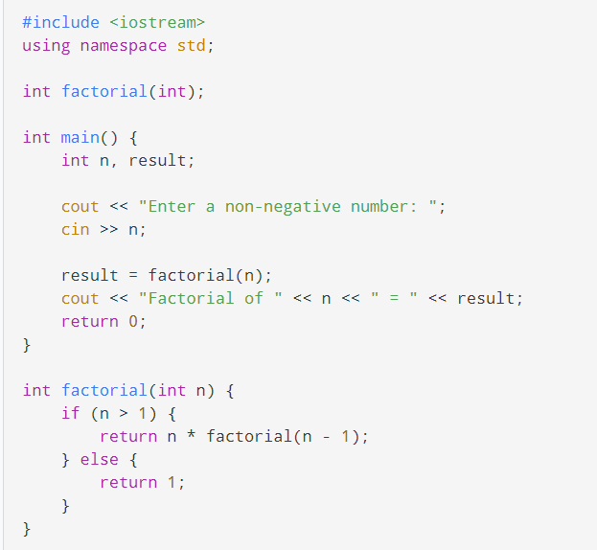
Example
Working of
factorial

Slide 17
Pros and cons of Recursion
Advantages of C++ Recursion
It makes our code shorter and cleaner.
Recursion is required in problems concerning data structures and advanced algorithms, such as Graph and Tree Traversal.
Disadvantages of C++ Recursion
It takes a lot of stack space compared to an iterative program.
It uses more processor time.
It can be more difficult to debug compared to an equivalent iterative program.

